Slide 1
ATME COLLEGE OF ENGINEERING
DEPARTMENT OF COMPUTER SCIENCE & ENGINEERING
A Project On
“Fire Detector IoT System with Extinguisher Class Recommendation”
Subject: Project Phase -2
Subject Code: BCS786
Submitted By
Dishanth J (4AD22CS028)
Harshith K V (4AD22CS034)
Harshith R (4AD22CS035)
Jithin Simon (4AD22CS039)
Under the Guidance of
Mrs. Roopa B
Assistant Professor
Dept. of CSE, ATMECE

Slide 2
CONTENTS
Introduction
Problem Statement
Objectives
Literature survey
Implementation Details
System Architecture
Results
Conclusion and Future enhancements
References

Slide 3
Introduction
Fire outbreaks poses significant threats to life, property, and the environment. Early detection and rapid response are crucial in minimizing the damage caused by such incidents.
The damage of the fire can be reduced if we can detect the fire early and notify the Emergency responders as soon as possible.
Proposed project presents an Internet of Things based fire detection system that identifies fire, recommends the appropriate fire extinguisher class, and sends notifications to emergency responders.

Slide 4
Problem Statement
Despite advances in IoT and deep learning-based fire detection, most systems focus on either sensors or video analysis, leading to accuracy and visibility limitations. Moreover, they rarely recommend the appropriate fire extinguisher. Therefore, a real-time, multi-sensor AI-based system integrating detection, object identification, and extinguisher recommendation is needed for effective emergency response

Slide 5
Objectives
IoT-based Fire Detection : Develop a system that utilizes IoT technology to monitor and detect fire incidents in time.
Extinguisher Class Recommendation : Integrate machine learning algorithms to analyze the incident and recommend the appropriate fire extinguisher class.
Emergency Alerts : Ensure immediate notification and alerting to enable quick response and enhance overall fire safety.

Slide 6
Literature Survey
[1] "IoT Based Smart Home and Office Fire Notification Alert System"
• Author : Sunandita Debnath, Jashwin Gautam, Sahil Kumar Rai
• Year of Conference: 2024.
⮚ Techniques and Approach: Employs a network of temperature, smoke, and CO sensors integrated with an Arduino UNO that communicates via cloud platform to trigger alarms, and notifications upon abnormal readings.
⮚ Advantages: Provides real-time monitoring, remote control via a mobile application, and demonstrates detection and responsiveness in extensive hardware testing.
⮚ Disadvantages: Relies on fixed threshold values(temperature >54 degree C, smoke level 40 ppm, CO level 70 ppm) that may not adapt well to varying conditions and lacks advanced machine learning for improved detection.

Slide 7
Literature Survey
[2] "A Smart Fire Detector IoT System with Extinguisher Class Recommendation Using Deep Learning"
• Author: Tareq Khan.
• Year of Conference: 2023.
⮚ Techniques and Approach: Utilizes thermal and RGB cameras with the deep learning model and homography transformation to detect fires and recommend the correct extinguisher class based on a lookup table.
⮚Advantages: Enhances detection and provides tailored extinguisher recommendations, enabling alerts and improved safety in indoor environments.
⮚ Disadvantages: Involves complex hardware(Jetson Nano’s CPU) and computationally intensive deep learning models that may increase costs alignment challenges.

Slide 8
Literature Survey
[3] "Forest Fire Detection and Notification Method Based on AI and IoT Approaches"
• Author: : Kuldoshbay Avazov, An Eui Hyun, Alabdulwahab Abrar Sami, Azizbek Khaitov, Akmalbek Bobomirzaevich Abdusalomov, and Young Im Cho.
• Year of Conference: 2023.
⮚ Techniques and Approach: Deploys IoT sensors to continuously monitor environmental parameters and applies deep learning algorithms to detect forest fires, subsequently notifying authorities via SMS.
⮚ Advantages: Improves detection using MQ -2 for smoke and paired with a camera for visual confirmation, processed by the YOLOv5 model.
⮚ Disadvantages: System could cause false detection, The MQ-2 sensor can be triggered by non-fire sources like dust or cigarette smoke.

Slide 9
Literature Survey
[4] "IoT Based Fire Detection and Warning System for Surveillance Applications using Deep Learning Model"
• Author: Sushmitha E. C., Alageswaran R., Ezhilarasie R.
• Year of Conference: 2023.
⮚ Techniques and Approach: Techniques and Approach: Uses surveillance cameras with a Raspberry Pi and a lightweight deep learning model (FireNet) based on MobileNet for detecting fire in real time.
⮚ Advantages: Provides high accuracy (97.4%), reduces false alarms, works in real time, and can trigger automated alert.
⮚ Disadvantages: Performance depends on dataset quality, limited by Raspberry Pi processing power, and may need larger datasets for real-world use.

Slide 10
Implementation Details
Image Capture (ESP32-CAM):
ESP32-CAM captures images and sends them to a local server via Wi-Fi.
Fire Detection (YOLOv8 Model):
The server runs YOLOv8 to check for fire and nearby objects.
The detected object is mapped to a fire extinguisher class (A, B, C, D or K).
Alert Generation:
An alert is created containing fire class, extinguisher recommendation, location, and timestamp.

Slide 11
Implementation Details
Notification Delivery:
Owner receives a push notification on the mobile app through Firebase Cloud Messaging
(FCM).
Responders receive an SMS/Email with the house address and extinguisher class.
Action Phase:
Owner can take immediate action with the recommended extinguisher type.
Emergency responders arrive at the location using the provided address.

Slide 12
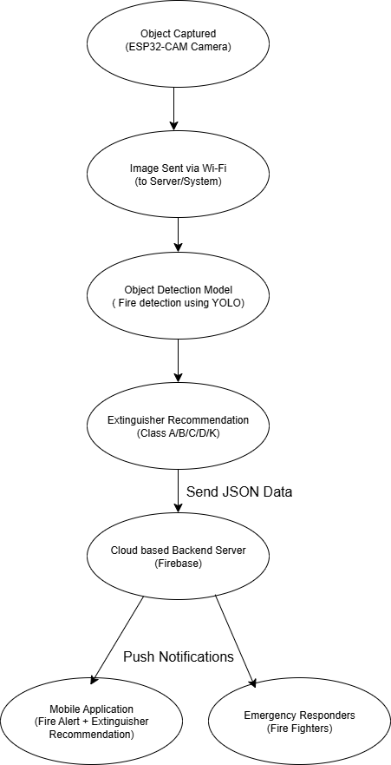
System Architecture

Slide 13
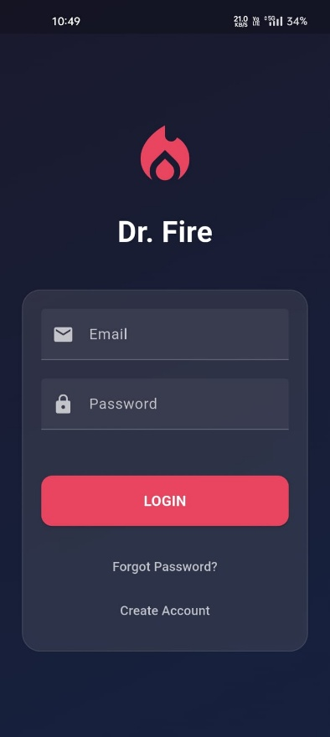

Results
LogIn Screen
Create Account Screen

Slide 14
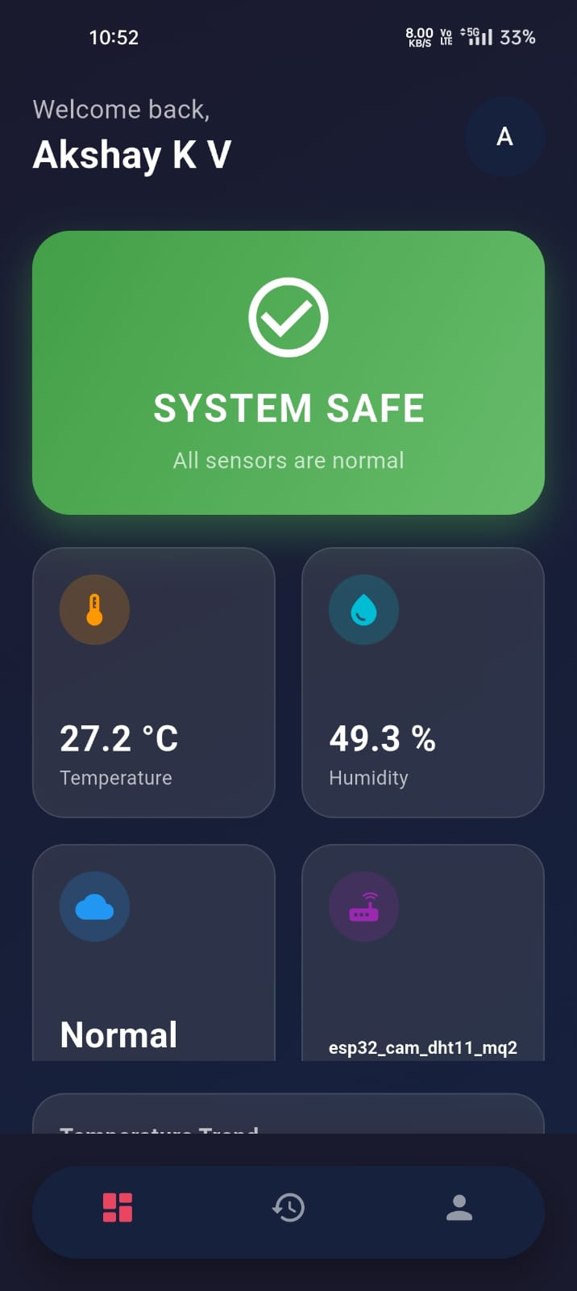
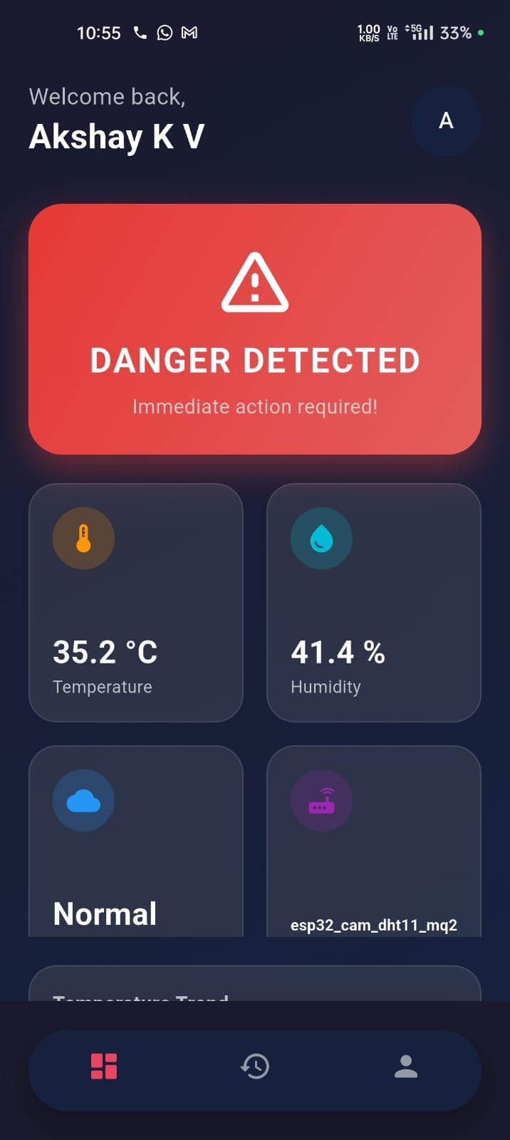
System Safe Dashboard
Danger Detected Dashboard

Slide 15
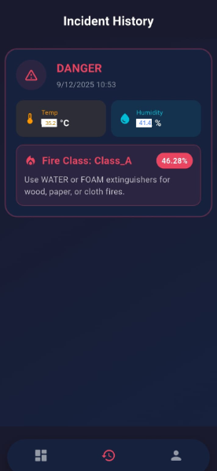

Incident History Screen
My Profile Screen

Slide 16
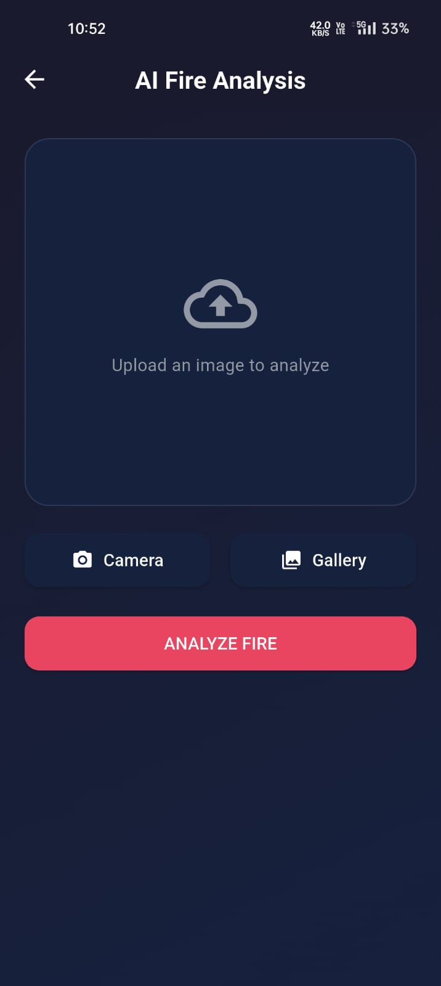
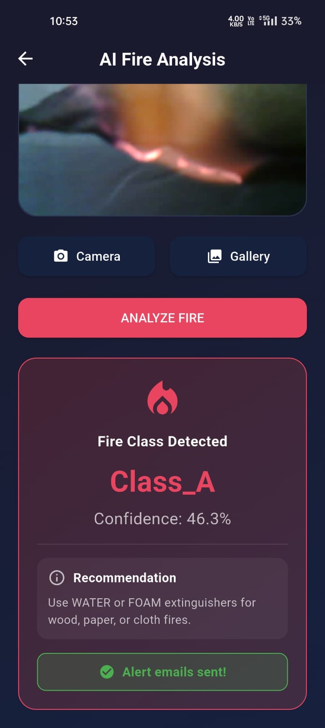
Model Fire Analysis (Upload Screen)
Model Fire Analysis (Result Screen)

Slide 17
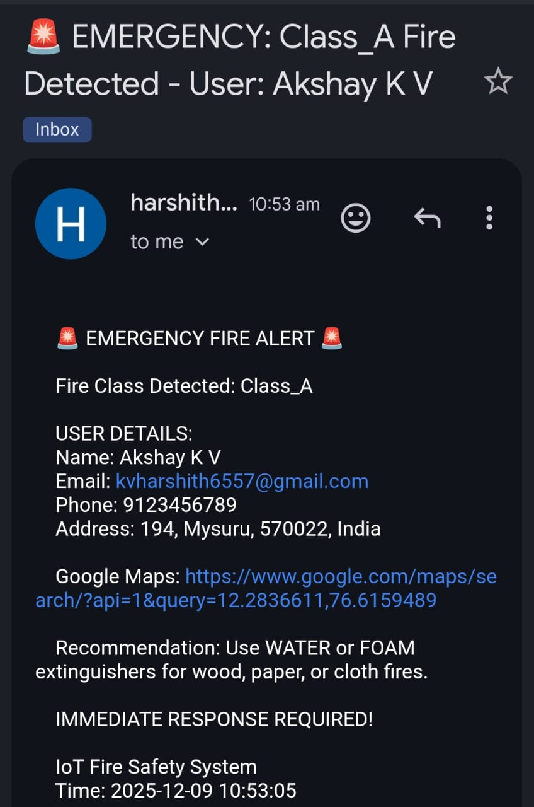
Emergency Alert Email Notification

Slide 18
Conclusion
The proposed IoT-based fire detection system successfully integrates multi-sensor data with YOLOv8-based image analysis to provide accurate and real-time fire detection.
By combining environmental sensing and visual confirmation, the system reduces false alarms and improves response time.
A key contribution of this work is automatic fire classification and correct extinguisher recommendation, enabling safer and more effective emergency response.
The system is reliable, cost-effective, and suitable for real-world deployment in residential, commercial, and industrial environments.

Slide 19
Future Enhancements
Future improvements will focus on enhancing detection accuracy under challenging conditions such as low light, heavy smoke, and partial obstructions by further optimizing the YOLOv8 model.
The system can be extended to integrate with automated fire suppression systems and smart building infrastructure for actions like automatic extinguisher activation, ventilation control, and emergency lighting.
Additionally, incorporating cloud-based analytics and predictive fire risk modeling will enable early warning, long-term analysis, and proactive fire safety management, making the system more intelligent and scalable.

Slide 20
References
[1] S. Debnath, J. Gautam, and S. K. Rai “IoT Based Smart Home and Office Fire Notification Alert System” , IEEE International Conference on Interdisciplinary Approaches in Technology and Management for Social Innovation (IATMSI) 2024.
[2] Tareq Khan , “A Smart Fire Detector IoT System with Extinguisher Class Recommendation Using Deep Learning”, IoT, Volume 4, Pages 558–581, 2023.
[3] K. Avazov, A. E. Hyun, A. A. Abrar Sami, A. Khaitov, A. B. Abdusalomov, and Y. I. Cho “Forest Fire Detection and Notification Method Based on AI and IoT Approaches”, Future Internet, 2023.
[4] Sushmitha E. C., Alageswaran R., and Ezhilarasie R., "IoT Based Fire Detection and Warning System for Surveillance Applications using Deep Learning Model," IEEE, 2023.

